Slide 1

SELENIUM AUTOMATION
Using Cucumber BDD Approach

Slide 2
Advantage of using approach
Selenium –
Automates browser interactions like clicking, typing, navigation.
Industry-standard for UI test automation; supports multiple browsers and languages.
Cucumber BDD
Write test cases in plain English using Gherkin syntax(Given-When-Then)
Make understandable to non technical stakeholders.
Page Object Model
design pattern to represent each webpage as a separate Java class.
Keeps locators and actions in one place.
Makes tests modular, reusable, and easy to maintain.

Slide 3
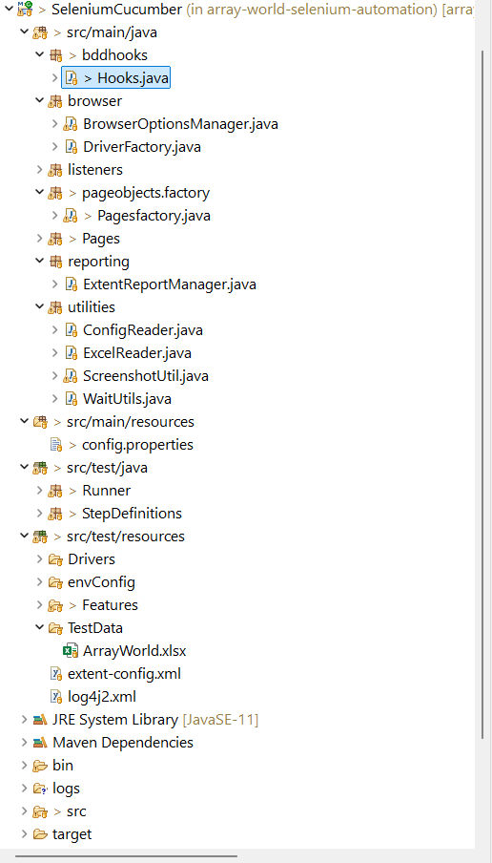
OVERview of framework

Slide 4
hooks
Block of code that runs before or after each step or scenario.
Initializes WebDriver, starts/stops Extent Reports, captures screenshots on failure.
Used for setup and teardown operations
Contains Cucumber Hooks like @Before,@After,@BeforeStep,@AfterStep
Advantages:
Reduces code duplication in step definitions.
Challenge if not used:
You'd need to repeat setup/teardown in each test or step definition.

Slide 5
Browser
BrowserOptionsManager
Utility class to set browser-specific options (ChromeOptions, FirefoxOptions, etc.).
Headless mode
Incognito mode
Disabling notifications
If we are not using,then Browser-specific flags scattered across code.
DriverFactory
Utility class to creates and manage WebDriver instances.
Helps to avoid duplicate driver initialization.
Central management of driver lifecycle.
Inconsistent WebDriver handling across the project.

Slide 6
Listeners
objects that "listen" for WebDriver events — like clicking an element, navigating to a URL, finding an element, etc.
used for event-based listeners (like WebDriverEventListener).
allow to hook into these events to perform additional actions such as:
Highlighting elements before clicking
Logging browser actions
Taking screenshots on failure
Debugging and reporting

Slide 7
Page factory
Central location to initialize all page object classes.
it manages WebDriver instance creation and ensures that it is used across all page objects.
If we are not using, step definition would repeatedly instantiate pages.

Slide 8
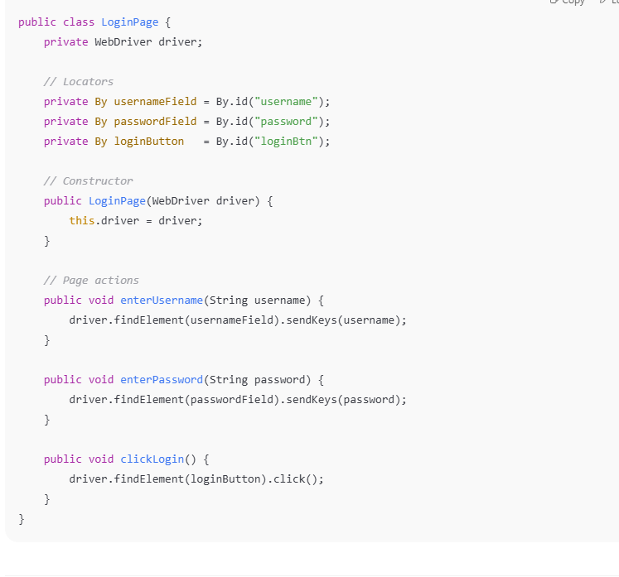
Pages
“Pages” refer to Page Object classes
Page object class contains
Web Elements – locators
Methods – login
Optional Validations – Assertions or verifications of page
Advantages
Reusable element definitions
Clean and maintainable code

Slide 9
Common Page methods
Page methods are the actions or behaviors that can be performed on a specific page or screen of your application.
select an option from a dropdown
perform mouse hover action
right click action
making your test automation code cleaner, reusable, maintainable, and less error-prone.

Slide 10
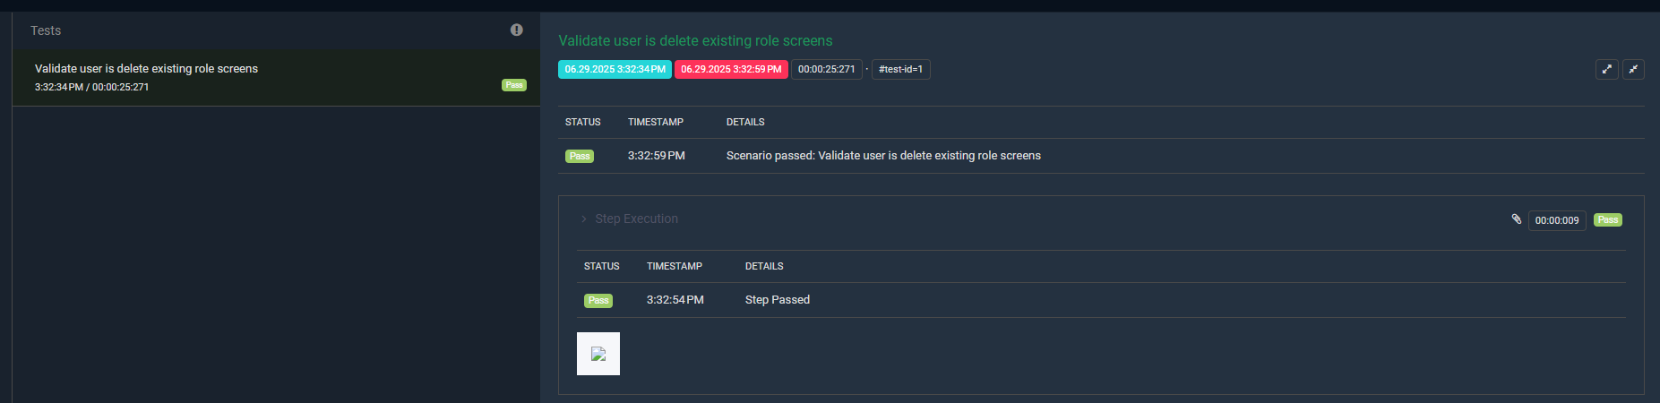
reporting
the process of generating a detailed summary of your test execution results.
Which tests passed or failed
Test execution time
Screenshots for failed steps (optional)
Logs or custom messages
Manages and configuration of extent reports.
Generate rich HTML test report
Capture test results,logs and screenshots

Slide 11
utilities
Config Reader
To read values from config.properties
Centralised access to env config
Excel Reader
Read test data from .xslx files
Data driven Testing
Screenshots
Capture screenshots

Slide 12
WaitUtlis
utility class to handle waits more effectively and cleanly. Instead of repeating wait code in every page or test, you centralize it.
To handle synchronization between:
Your test code
The actual state of the web page
Contains explicit wait methods WebDriver waits
If we are not using, then Thread.sleep() needs to use which is a dead wait(increase flakiness)

Slide 13
Resources
Config.properties
Contains configurations like browser,URL,timeout.
Advantage
Easily changes settings without modifying code
Without using – hardcode values reduces maintainability

Slide 14
runner
To execute cucumber files
Main entry point for the features or testcases to run
Contains cucumber runner class annotated with @cucumberoptions
@RunWith - Tells JUnit to run this class using the Cucumber test runner.
features – tells the path of the feature
Plugin – sets up reporting
glue – tells cucumber where to find step definition and hooks

Slide 15
dry run –
true – checks all steps in .feature file have matching step definition
false – run the test
Tags – runs only scenarios or feature tagged
Monochrome – make console output cleaner and more readable

Slide 16
Step definition
Bridge between Gherkin and actual automation logic
tells Cucumber what code to run when it sees a step in the .feature file

Slide 17
Driver
Contains executable driver files
envConfig
Hold environment specific property files(dev,test,prod)

Slide 18
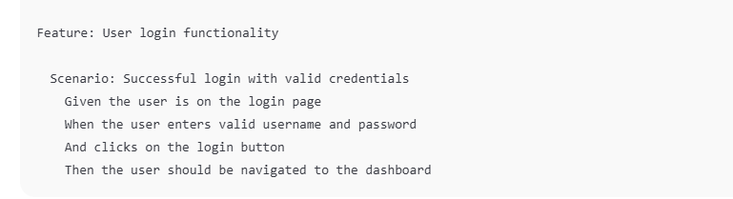
Features
Text file written in Gherkin language
Define scenarios using Given-When-Then
Contains all the .feature file
Feature File contains
Feature – Description of what you are testing
Scenario – Single Test case
Steps – Use Gherkin keywords to describe each step

Slide 19
TestData –
Excel file containing test data
Used by excel reader for data driven testing
Extent Config
Customize extent report layout(title,theme,char visibility)
Reports for stakeholders
Log4j
Configure logging using log4j
Log test actions,debug info and failure
No proper logging or debugging trail

Slide 20
Pom file
Project Object Model
Core file used in maven projects
Manages all project dependencies, build configurations, plugins, and project metadata

Slide 21
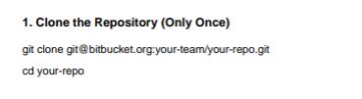
Pre-requisite for CODE

Slide 22
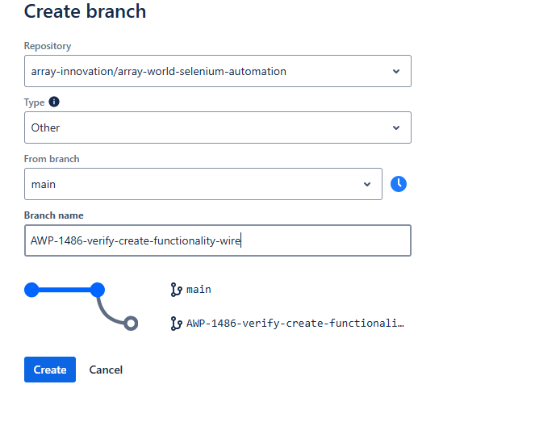
Testing Process
Create Task in JIRA
From task, create branch
Once you login into BitBucket,create the branch
for the task

Slide 23
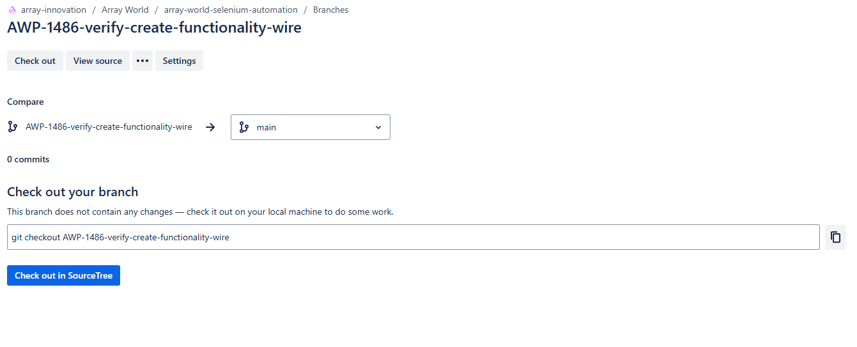
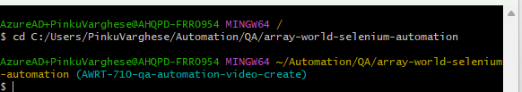
Copy the git checkout branch
Open GitBash
Navigate to your code on local
using cd path

Slide 24
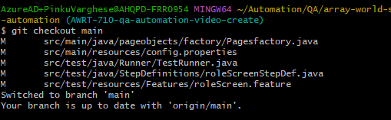

Checkout to the main branch using
git checkout main
Pull the latest code from main branch using
git pull origin main
Now move back to the branch created for the task using
git checkout branch_name

Slide 25
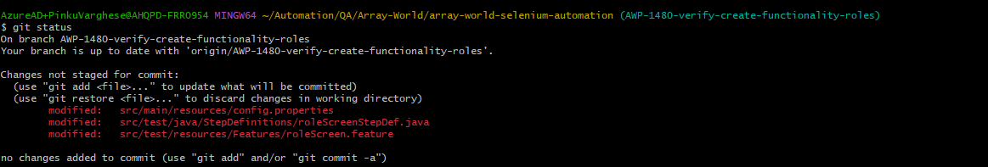
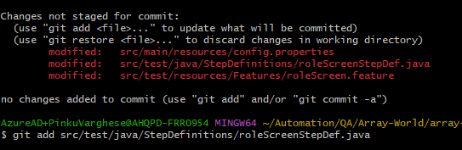
Make changes or add the features related to the task
Once it is done and ready for pushing ,follow below steps
git status – will provide the latest changes done
git add filepath – add the files which needs to be pushed

Slide 26
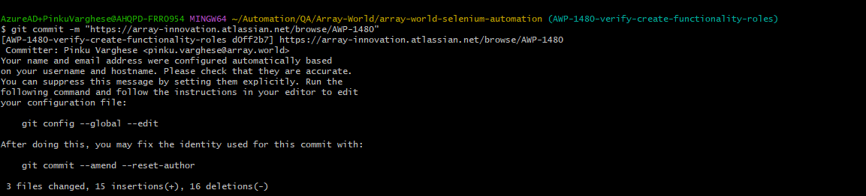
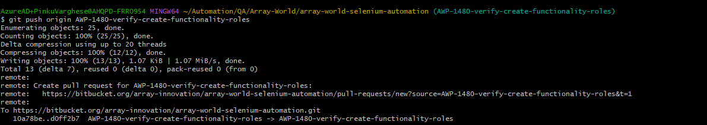
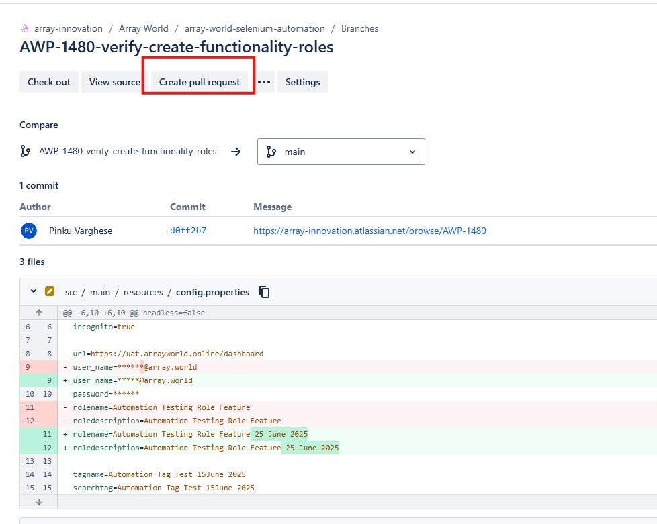
Commit the code using
git commit –m “Message”
Push the code to the branch
Git push origin branch_name
Navigate to the branch in bitbucket
Create Pull request

Slide 27
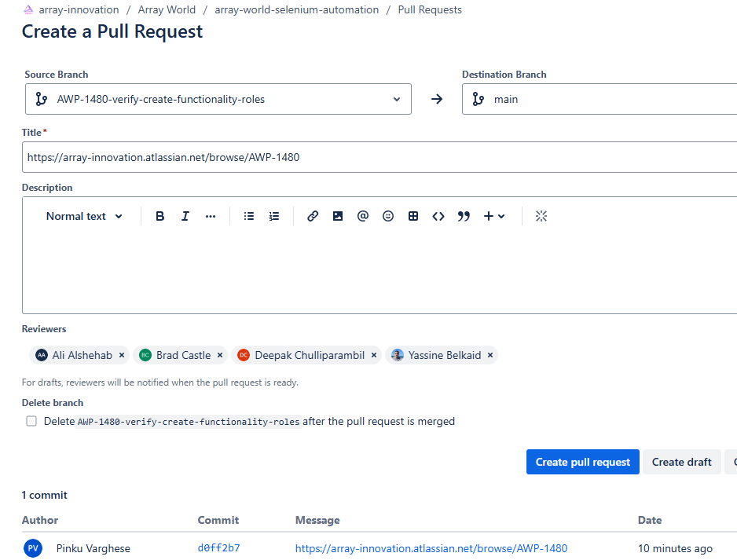
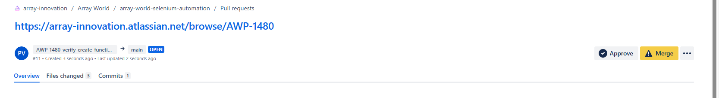
Add necessary details and create
Once reviewers verify the code and approves it,you can merge the code

